Slide 1
CPE 323 Intro to Embedded Computer Systems Analog-to-Digital Conversion
Aleksandar Milenkovic
milenka@uah.edu

Slide 2
Admin

Slide 3
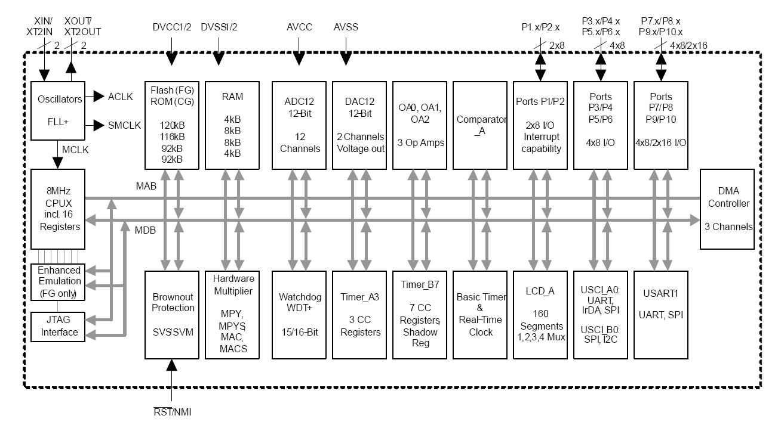
MSP430FG4618 Block Diagram

Slide 4
MSP430F5529 Block Diagram

Slide 5
Interfacing Physical World: From Analog Signals to Digital Values
Sensors/Transducers
convert physical quantity into an electrical signals
Signal Conditioning
isolation from dangerous voltages due to static discharges
amplification of signals
bandwidth limiting: filters
Analog-to-Digital Converters
convert analog signals to digital values

Slide 6
System View: From Input Analog Voltage to Bits

Slide 7
ADC Modules
Analog Multiplexer
Sample-and-hold
AD Conversion Core
Buffers

Slide 8
Definitions
Resolution
Accuracy
Transfer Function
Aperture Time
Conversion Time
Sampling Frequency

Slide 9
AD Transfer Function

Slide 10
Input Analog MUX

Slide 11
Sample&Hold

Slide 12
ADC Core

Slide 13
Successive Approximation Register (SAR) ADC Core

Slide 14
Parallel ADC Core

Slide 15
MSP430 ADC12

Slide 17
Walk Through
Fs=10,000 Hz (sampling rate)
Ts=
Vmin=
Vmax=
Find samples for one period

Slide 19

Measuring Temperature (on-chip temperature sensor on MSP430F5529)
Input channel INCHx=1010 (10)
Temperature sensor equations
Sample time > 30 μs
Calibration may be needed
TCsensor – slope (mV/°C),
Vsensor – intercept (mV)
$$V_{sense}={TC}_{sensor}∙Temp+V_{sensor}$$
$TEMPC=(ADC.raw −CAL_ADC_T30)×\frac{85−30}{CAL_ADC_T85−CAL_ADC_T30}$ + 30

Slide 20
Demo

Slide 21
Demo (cont’d)

